Slide 1
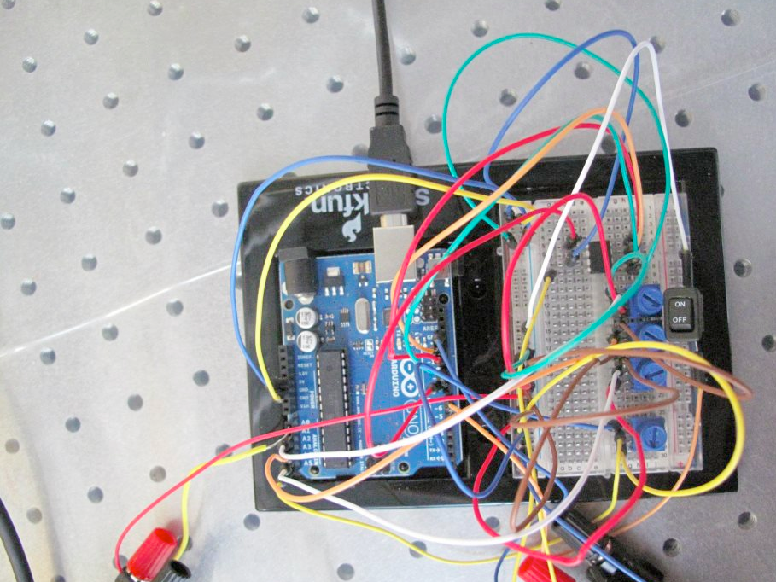
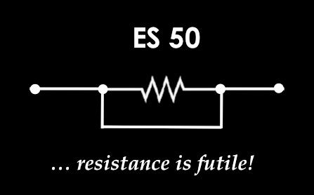
ES 50: Introduction to Electrical Eng.
Explore EE, satisfy a Gen Ed requirement & have fun

Slide 2
Lecture 13: Finite State Machines
October 30, 2017

Slide 3
Announcements
Project Proposals
Comments are in the Google Sheet
Each team has been assigned a TF mentor. Please reach out to setup a meeting time this week
Parts List
Due on Friday uploaded to CANVAS, only one per team
You will need to work with your TF mentor to determine appropriate parts as we can only order for certain websites
Problem Set 7
Due normal time on Friday

Slide 4








Last Time
Sequential Logic
SR Latch
Synchronous vs. Asynchronous Circuits
Basic Timing Diagram
S | R | Q(t+1)
0 | 0 | Q(t) no change
0 | 1 | 0
1 | 0 | 1
1 | 1 | undefined
$$R$$
$$Q$$
$$R$$
$$Q$$
$$S$$
$$\overline{Q}$$
$$\overline{Q}$$
$$S$$

Slide 5
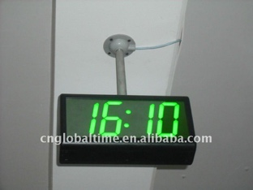
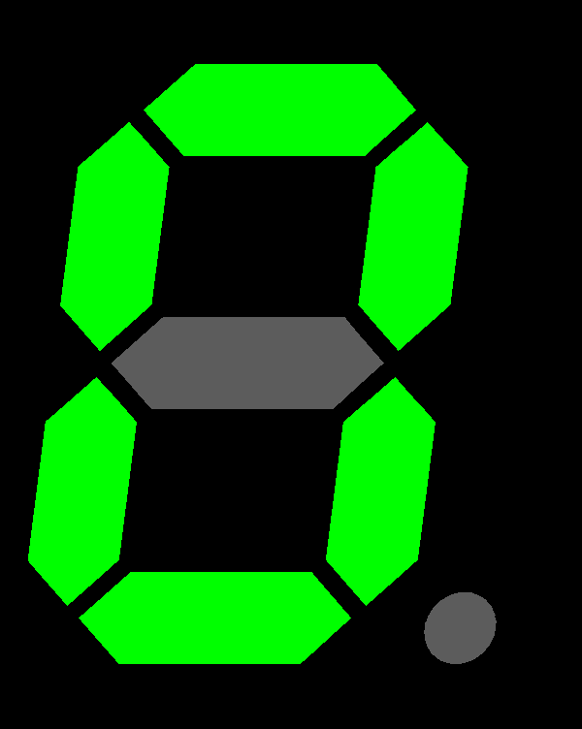


Digital Logic So Far
A_{n}
B_{n}
C_{n-1}
𝛴_{n}
C_{n}
In₀
$$D$$
$$Q$$
Out₀
$$\overline{Q}$$
In₁
$$D$$
$$Q$$
Out₁
$$\overline{Q}$$
In₀
Register
Out₀
In₂
$$D$$
$$Q$$
Out₂
In₁
Out₁
$$\overline{Q}$$
$$D$$
$$Q$$
In₂
Out₂
In₃
Out₃
In₃
$$D$$
$$Q$$
Out₃
$$\overline{Q}$$
$$\overline{Q}$$
CLK
What else can we do with small simple logic circuits?

Slide 6
Finite State Machine (FSM)
An abstraction used to design digital logic (computer programs). It is composed of a finite number of states, transitions, outputs, & inputs.
Examples: vending machines, ATMs, counters, alarm systems…
FSMs can be implemented use sequential logic
State diagram is used to represent the operation of a FSM
{a,x}
States: S_{m}, S_{n}
Inputs: a
Outputs: x
S_{m}
S_{n}
Each state is a result of all previous inputs
FSM has memory so flip-flops are needed to represent states
Output of FSM depends on current state & current inputs

Slide 7
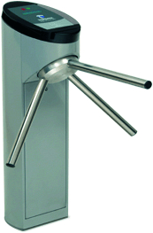
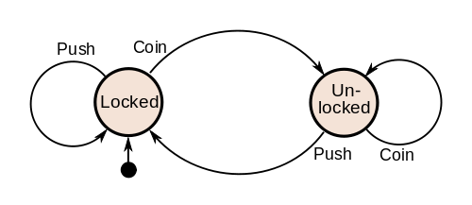

Turnstile
Used to control entry of exit into some location
  Possible States
  Locked & Unlocked
  Possible Actions
  Insert Coin/Payment
  Push turnstile

Slide 8
Procedure for Synthesis of FSM
Name all possible states
Consider all possible inputs, for every state
Label input & outputs for each transition between states
Draw the diagram: you need to consider every possible input in each state
  Otherwise transitions of the FSM may be undefined for certain input aka machine freezes or blue screen of death
Example: Mod 6 counter
  Counter counts up when a button is pressed. When it counts up to 6, light bulb lights up, and counter is reset to state 0.
  Inputs: {button not pressed, button pressed} ⬄ {0,1}
  Outputs: {light off, light on} ⬄ {0, 1}
  States: {0, 1, 2, 3, 4, 5}
{1,0}
{1,0}
{1,0}
{1,0}
{1,0}
{in,out}
0
1
2
3
4
5
{0,0}
{0,0}
{0,0}
{0,0}
{0,0}
{0,0}
{1,1}

Slide 9
Example: 2011 Quiz
The elevator in Maxwell-Dworkin building operates between the ground floor (G) and any of the three floors (1, 2, 3). The elevator has 4 buttons (G, 1, 2, 3), two LED indicators (UP & DOWN), & a sound indicator (SOUND). This elevator can be realized as a finite state machine that operates according to the following rules:
A student pushes one of the four buttons to select the desired destination floor. Once one of the floors is selected, additional selections are ignored.
If the destination is higher than the origin, the elevator goes up to the desired floor & UP arrow is lit.
If the destination is lower than the origin, the elevator goes down to the desired floor, & DOWN arrow is lit.
If the destination is the same as the origin, the elevator does not move, & SOUND is activated to remind a sleepy student that she/he is already at the desired floor.
  You do not have to worry about sending signals to the elevator’s motor to tell it to start or stop moving. Also, you don’t have to consider the control panels at each floor.
What are the states, inputs and outputs of this finite state machine?
Draw the state diagram of the FSM.
How many flip-flops would be needed to implement this FSM? How many input and output wires would you need, assuming that both inputs and outputs are encoded.

Slide 10
MD Elevator Finite State Machine
States: {G,1,2,3}
Inputs: {G,1,2,3}, but we can also do nothing → {nothing,G,1,2,3}
Outputs: {up,down,sound,nothing}
Flip-Flops: 2 (4 states)
Input wires: 3 (5 inputs)
If we are clever, this be reduced to two by using the CLK as an input
Output wires: 2 (4 outputs)
{G,sound}
{1,sound}
{in,out}
{1,up}
G
1
{none,none}
{none,none}
{G,down}
{2,up}
{3,up}
{G,down}
{3,up}
{1,down}
{2,up}
{1,down}
{G,down}
3
{2,down}
2
{none,none}
{none,none}
{3,up}
{3,sound}
{2,sound}

Slide 11
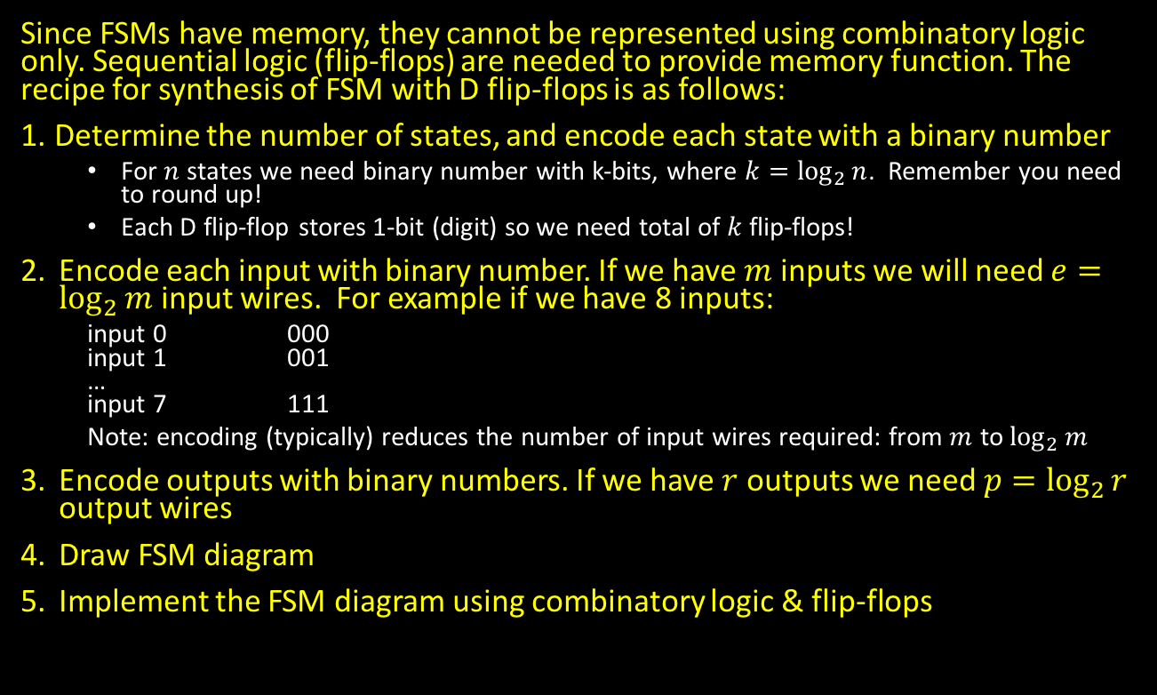
Implementation of FSM using Flip-Flops
Since FSMs have memory, they cannot be represented using combinatory logic only. Sequential logic (flip-flops) are needed to provide memory function. The recipe for synthesis of FSM with D flip-flops is as follows:
Determine the number of states, and encode each state with a binary number
  For $n$ states we need binary number with k-bits, where $k=\log_{2}{n}$. Remember you need to round up!
  Each D flip-flop stores 1-bit (digit) so we need total of $k$ flip-flops!
Encode each input with binary number. If we have $m$ inputs we will need $e=\log_{2}{m}$ input wires. For example if we have 8 inputs:
  input 0 000
  input 1 001
  …
  input 7 111
  Note: encoding (typically) reduces the number of input wires required: from $m$ to $\log_{2}{m}$
Encode outputs with binary numbers. If we have $r$ outputs we need $p=\log_{2}{r}$ output wires
Draw FSM diagram
Implement the FSM diagram using combinatory logic & flip-flops

Slide 12
Another Problem
Using synchronous D flip-flops realize 2-bit counter that counts 0, 1, 2, 3, 0, 1, 2… and so on when its input COUNT=1. When COUNT=0, counter remains in 0. Implement the counter using D flip-flops & necessary logic.
Modify the outputs of the counter that you synthesized in part (a) by adding necessary logic, in order to produce:
  The sequence of even numbers between 0 & 7 when signal EVEN=1 (output should be 0, 2, 4, 6, 0, 2, 4, 6, etc)
  The sequence of odd numbers between 0 & 7 (7 included) when signal EVEN=0 (output should be 1, 3, 5, 7, 1, 3, 5, 7, etc)
In both parts you can use any logic gate with as many inputs as you wish. For part (b) you HAVE TO use the counter that you realized in (a) – you cannot synthesize brand new counter. Please use the diagram provided below & complete it with necessary logic. Show all work, and in particular truth tables & logic equations

Slide 13
Another Problem – Part A
Using synchronous D flip-flops realize 2-bit counter that counts 0, 1, 2, 3, 0, 1, 2… and so on when its input COUNT=1. When COUNT=0, counter remains in 0. Implement the counter using D flip-flops & necessary logic.
Count | Q₁(t) | Q₀(t)
0 | 0 | 0
0 | 0 | 1
0 | 1 | 0
0 | 1 | 1
1 | 0 | 0
1 | 0 | 1
1 | 1 | 0
1 | 1 | 1
Q₁(t+1) | Q₀(t+1)
Q₁(t+1) | Q₀(t+1)
0 | 0
0 | 0
0 | 0
0 | 0
0 | 1
1 | 0
1 | 1
0 | 0
Q₁
$$D$$
$$Q$$
Q₁
Q₀
CLK
$$\overline{Q}$$
$$Q_{1}\left(t+1\right)=CQ_{1}^{′}Q_{0}+CQ_{1}Q_{0}^{′}$$
$Q_{1}\left(t+1\right)=C(Q_{1}^{′}Q_{0}+Q_{1}Q_{0}^{′})$
$Q_{1}\left(t+1\right)=C(Q_{0}⨁Q_{1})$
$$Q_{0}\left(t+1\right)=CQ_{1}^{′}Q_{0}^{′}+CQ_{1}Q_{0}^{′}$$
$Q_{0}\left(t+1\right)=CQ_{0}^{′}(Q_{1}^{′}+Q_{1})$
$Q_{0}\left(t+1\right)=CQ_{0}^{′}$
Count
Q₀
$$D$$
$$Q$$
$$\overline{Q}$$

Slide 14
Another Problem – Part B
Modify the outputs of the counter that you synthesized in part (a) by adding necessary logic, in order to produce:
  The sequence of even numbers between 0 and 7 when signal EVEN=1 (output should be 0, 2, 4, 6, 0, 2, 4, 6, etc)
  The sequence of odd numbers between 0 and 7 (7 included) when signal EVEN=0 (output should be 1, 3, 5, 7, 1, 3, 5, 7, etc)
$$Z_{2}=E^{′}Q_{1}Q_{0}^{′}+E^{′}Q_{1}Q_{0}+EQ_{1}Q_{0}^{′}+EQ_{1}Q_{0}$$
$Z_{2}=Q_{1}Q_{0}^{′}(E^{′}+E)+Q_{1}Q_{0}(E^{′}+E)$
$Z_{2}=Q_{1}Q_{0}^{′}+Q_{1}Q_{0}$
$Z_{2}=Q_{1}(Q_{0}^{′}+Q_{0})$
$Z_{2}=Q_{1}$
$$Z_{1}=E^{′}Q_{1}^{′}Q_{0}+E^{′}Q_{1}Q_{0}+EQ_{1}^{′}Q_{0}+EQ_{1}Q_{0}$$
$Z_{1}=Q_{1}^{′}Q_{0} (E^{′}+E)+Q_{1}Q_{0}(E^{′}+E)$
$Z_{1}=Q_{1}^{′}Q_{0}+Q_{1}Q_{0}$
$Z_{1}=Q_{0}(Q_{1}^{′}+Q_{1})$
$Z_{1}=Q_{0}$
$$Z_{0}=E^{′}Q_{1}^{′}Q_{0}^{′}+E^{′}Q_{1}^{′}Q_{0}+E^{′}Q_{1}Q_{0}^{′}+E^{′}Q_{1}Q_{0}$$
$Z_{0}=E′(Q_{1}^{′}Q_{0}^{′}+Q_{1}^{′}Q_{0}+Q_{1}Q_{0}^{′}+Q_{1}Q_{0})$
$Z_{0}=E^{′}[Q_{1}^{′}\left(Q_{0}^{′}+Q_{0}\right)+Q_{1}\left(Q_{0}^{′}+Q_{0}\right)]$
$Z_{0}=E^{′}\left[Q_{1}^{′}+Q_{1}\right]$
$Z_{0}=E′$
Even | Q₁(t+1) | Q₀(t+1)
0 | 0 | 0
0 | 0 | 1
0 | 1 | 0
0 | 1 | 1
1 | 0 | 0
1 | 0 | 1
1 | 1 | 0
1 | 1 | 1
Z₂ | Z₁ | Z₀
0 | 0 | 1
0 | 1 | 1
1 | 0 | 1
1 | 1 | 1
0 | 0 | 0
0 | 1 | 0
1 | 0 | 0
1 | 1 | 0
Z₂ | Z₁ | Z₀

Slide 15
Another Problem – Part C
In both parts you can use any logic gate with as many inputs as you wish. For part (b) you HAVE TO use the counter that you realized in (a) – you cannot synthesize brand new counter. Please use the diagram provided below and complete it with necessary logic. Show all work, and in particular truth tables & logic equations.
$$Z_{2}=Q_{1}$$
$$Z_{1}=Q_{0}$$
$$Z_{0}=E′$$
Q₁
$$D$$
$$Q$$
Q₁
Z₂
Q₀
Z₁
CLK
$$\overline{Q}$$
Z₀
Count
Q₀
$$D$$
$$Q$$
$$\overline{Q}$$
Even

Slide 16
Quiz 2, Fall 2015
Counters are commonly used in digital systems & there are many different ways to count. One way is to use Gray codes (see truth table). Notice that Gray coding has the interesting property that each code only changes by 1 bit as it sequences from one number to the next.
Let’s design a modulo-5 Gray code up/down counter using combinational logic gates & positive edge-triggered D flip-flops. Recall that a modulo-5 counter counts up from 0 to 4 and then repeats. Assume the following properties for this counter:
Counter has two inputs: CLK & UP
Counter output changes on each rising edge of the clock signal CLK
When UP = 1, the counter counts up as follows: … 3, 4, 0, 1, 2, 3, 4 …
When UP = 0, the counter counts down as follows: … 3, 2, 1, 0, 4, 3, 2, …
Counter output corresponds to its present state.
Decimal | Binary | Gray
0 | 000 | 000
1 | 001 | 001
2 | 010 | 011
3 | 011 | 010
4 | 100 | 110
5 | 101 | 111
6 | 110 | 101
7 | 111 | 100
How many states does the counter have?
Draw the state diagram for the FSM that implements the counter. You only need to label the inputs for the transition arrows since the output corresponds to the present state.
Write the truth table for the counter.
What are the Boolean expressions for $D_{2}$, $D_{1}$, and $D_{0}$ in terms of $Q_{2}(t)$, $Q_{1}(t)$, $Q_{0}(t)$, and UP?
Design the combinational logic to implement the modulo-5 Gray code up/down counter.

Slide 17
Quiz 2, Fall 2015 – Part A
Let’s design a modulo-5 Gray code up/down counter using combinational logic gates and positive edge-triggered D flip-flops. Recall that a modulo-5 counter counts up from 0 to 4 and then repeats. Assume the following properties for this counter:
Counter has two inputs: CLK and UP
Counter output changes on each rising edge of the clock signal CLK
When UP = 1, the counter counts up as follows: … 3, 4, 0, 1, 2, 3, 4 …
When UP = 0, the counter counts down as follows: … 3, 2, 1, 0, 4, 3, 2, …
Counter output corresponds to its present state
How many states does the counter have?
  5 states: {0, 1, 2, 3, 4}

Slide 18
Quiz 2, Fall 2015 – Part B
Draw the state diagram for the FSM that implements the counter. You only need to label the inputs for the transition arrows since the output corresponds to the present state.
Decimal | Binary | Gray
0 | 000 | 000
1 | 001 | 001
2 | 010 | 011
3 | 011 | 010
4 | 100 | 110
Counter has two inputs: CLK and UP
Counter output changes on each rising edge of the clock signal CLK
When UP = 1, the counter counts up as follows: … 3, 4, 0, 1, 2, 3, 4 …
When UP = 0, the counter counts down as follows: … 3, 2, 1, 0, 4, 3, 2, …
Counter output corresponds to its present state.
1
1
1
1
0
000
001
011
010
110
0
0
0
0
1
If you chose to include the CLK that’s ok but not necessary

Slide 19
Quiz 2, Fall 2015 – Part C
Write the truth table for the counter.
Decimal | Binary | Gray
0 | 000 | 000
1 | 001 | 001
2 | 010 | 011
3 | 011 | 010
4 | 100 | 110
 | Current State |  |  | Input | Next State |  |  | Flip-Flops
 | Q₂(t) | Q₁(t) | Q₀(t) | UP | Q₂(t+1) | Q₁(t+1) | Q₀(t+1) | D₂ | D₁ | D₀
0 | 0 | 0 | 0 | 0 | 1 | 1 | 0 | 1 | 1 | 0
 |  |  |  | 1 | 0 | 0 | 1 | 0 | 0 | 1
1 | 0 | 0 | 1 | 0 | 0 | 0 | 0 | 0 | 0 | 0
 |  |  |  | 1 | 0 | 1 | 1 | 0 | 1 | 1
2 | 0 | 1 | 1 | 0 | 0 | 0 | 1 | 0 | 0 | 1
 |  |  |  | 1 | 0 | 1 | 0 | 0 | 1 | 0
3 | 0 | 1 | 0 | 0 | 0 | 1 | 1 | 0 | 1 | 1
 |  |  |  | 1 | 1 | 1 | 0 | 1 | 1 | 0
4 | 1 | 1 | 0 | 0 | 0 | 1 | 0 | 0 | 1 | 0
 |  |  |  | 1 | 0 | 0 | 0 | 0 | 0 | 0
 | Current State |  |  | Input
 | Q₂(t) | Q₁(t) | Q₀(t) | $$↑$$
0 | 0 | 0 | 0 | 0
 |  |  |  | 1
1 | 0 | 0 | 1 | 0
 |  |  |  | 1
2 | 0 | 1 | 1 | 0
 |  |  |  | 1
3 | 0 | 1 | 0 | 0
 |  |  |  | 1
4 | 1 | 1 | 0 | 0
 |  |  |  | 1
Next State
Q₂(t+1) | Q₁(t+1) | Q₀(t+1)
1 | 1 | 0
0 | 0 | 1
0 | 0 | 0
0 | 1 | 1
0 | 0 | 1
0 | 1 | 0
0 | 1 | 1
1 | 1 | 0
0 | 1 | 0
0 | 0 | 0
Next State
Q₂(t+1) | Q₁(t+1) | Q₀(t+1)
Flip-Flops
D₂ | D₁ | D₀
Flip-Flops
D₂ | D₁ | D₀
1 | 1 | 0
0 | 0 | 1
0 | 0 | 0
0 | 1 | 1
0 | 0 | 1
0 | 1 | 0
0 | 1 | 1
1 | 1 | 0
0 | 1 | 0
0 | 0 | 0

Slide 20
Quiz 2, Fall 2015 – Part D
What are the Boolean expressions for $D_{2}$, $D_{1}$, & $D_{0}$ in terms of $Q_{2}(t)$, $Q_{1}(t)$, $Q_{0}(t)$, & UP?
Current State |  |  | Input
Q₂(t) | Q₁(t) | Q₀(t) | $$↑$$
0 | 0 | 0 | 0
 |  |  | 1
0 | 0 | 1 | 0
 |  |  | 1
0 | 1 | 1 | 0
 |  |  | 1
0 | 1 | 0 | 0
 |  |  | 1
1 | 1 | 0 | 0
 |  |  | 1
Flip-Flops
D₂ | D₁ | D₀
1 | 1 | 0
0 | 0 | 1
0 | 0 | 0
0 | 1 | 1
0 | 0 | 1
0 | 1 | 0
0 | 1 | 1
1 | 1 | 0
0 | 1 | 0
0 | 0 | 0
$$D_{2}=Q_{2}^{′}Q_{1}^{′}Q_{0}^{′}↑^{′}+Q_{2}^{′}Q_{1}Q_{0}^{′}↑$$
$=Q_{2}^{′}Q_{0}^{′}\left(Q_{1}^{′}↑^{′}+Q_{1}↑\right)$
$$D_{2}=Q_{2}^{′}Q_{0}^{′}\left(Q_{1}⨁↑\right)′$$
$$D_{1}^{′}=Q_{2}^{′}Q_{1}^{′}Q_{0}^{′}↑+Q_{2}^{′}Q_{1}^{′}Q_{0}↑^{′}+Q_{2}^{′}Q_{1}Q_{0}↑^{′}+Q_{2}Q_{1}Q_{0}^{′}↑$$
$=Q_{0}^{′}↑\left(Q_{2}^{′}Q_{1}^{′}+Q_{2}Q_{1}\right)+Q_{2}^{′}Q_{0}↑^{′}\left(Q_{1}+Q_{1}^{′}\right)$
$=Q_{0}^{′}↑\left(Q_{2}⨁Q_{1}\right)′+Q_{2}^{′}Q_{0}↑^{′}$
$$D_{1}=\left[Q_{0}^{′}↑\left(Q_{2}⨁Q_{1}\right)′+Q_{2}^{′}Q_{0}↑^{′}\right]′$$
$$D_{0}=Q_{2}^{′}Q_{1}^{′}Q_{0}^{′}↑+Q_{2}^{′}Q_{1}^{′}Q_{0}↑+Q_{2}^{′}Q_{1}Q_{0}↑^{′}+Q_{2}^{′}Q_{1}Q_{0}^{′}↑^{′}$$
$=Q_{2}^{′}Q_{1}^{′}↑\left(Q_{0}^{′}+Q_{0}\right)+Q_{2}^{′}Q_{1}↑^{′}\left(Q_{0}+Q_{0}^{′}\right) =Q_{2}^{′}Q_{1}^{′}↑+Q_{2}^{′}Q_{1}↑^{′}$
$=Q_{2}^{′}(Q_{1}^{′}↑+Q_{1}↑^{′})$
$$D_{0}=Q_{2}^{′}(Q_{1}⨁↑)$$

Slide 21
Quiz 2, Fall 2015 – Part E
Design the combinational logic to implement the modulo-5 Gray code up/down counter.
$$D_{2}=Q_{2}^{′}Q_{0}^{′}\left(Q_{1}⨁↑\right)′$$
$$D_{1}=\left[Q_{0}^{′}↑\left(Q_{2}⨁Q_{1}\right)′+Q_{2}^{′}Q_{0}↑^{′}\right]′$$
$$D_{0}=Q_{2}^{′}(Q_{1}⨁↑)$$
Q₂
$$D$$
$$Q$$
Q₂
Q₁
$$\overline{Q}$$
Q₀
Q₁
$$D$$
$$Q$$
$$\overline{Q}$$
Q₀
$$D$$
$$Q$$
UP
CLK
$$\overline{Q}$$

Slide 22
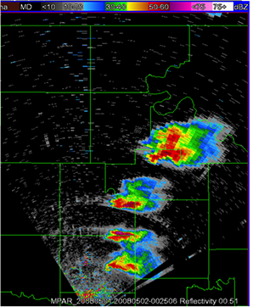
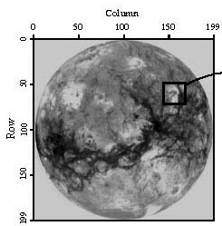
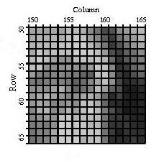
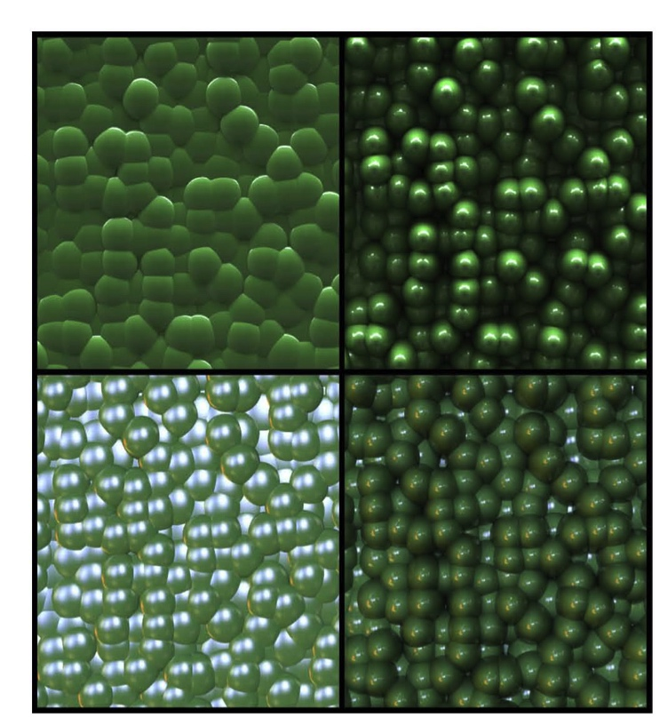
Next Time
Images as 2D Signals!
Image Processing

